Slide 1
Brain MRI Images for Brain Tumor Detection

Slide 2
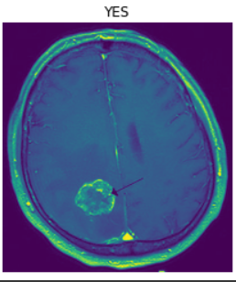
Data
https://www.kaggle.com/navoneel/brain-mri-images-for-brain-tumor-detection
155 images of brain tumor and 98 images of normal brain.
I split the data into 3 categories train, validation and test.
193 Images for Training, 50 images for validation, and 10 for unseen data.

Slide 3
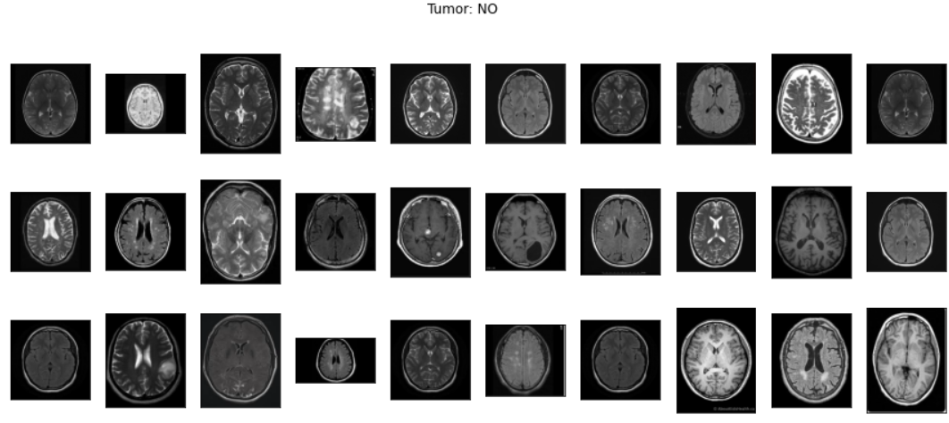

Slide 4
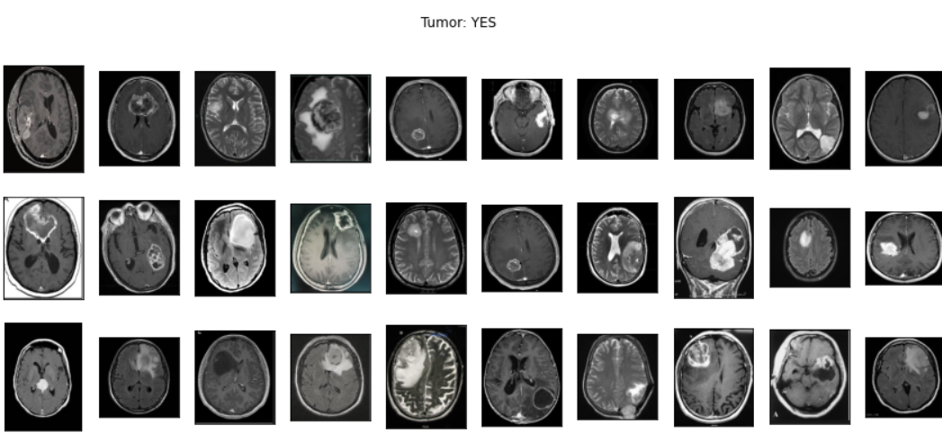

Slide 5
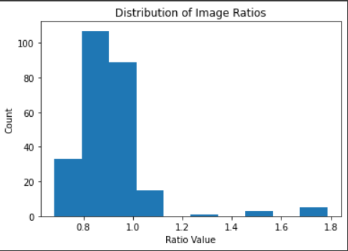
Distribution of images ratios

Slide 6
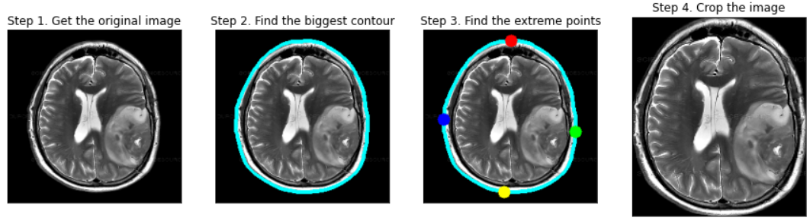
Cropping the Image

Slide 7
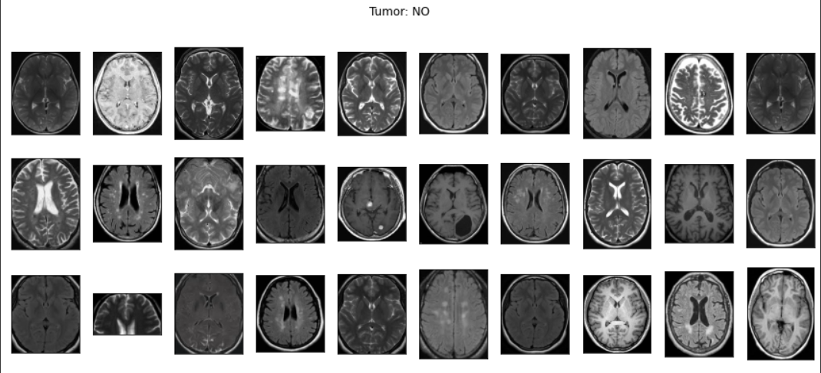

Slide 8
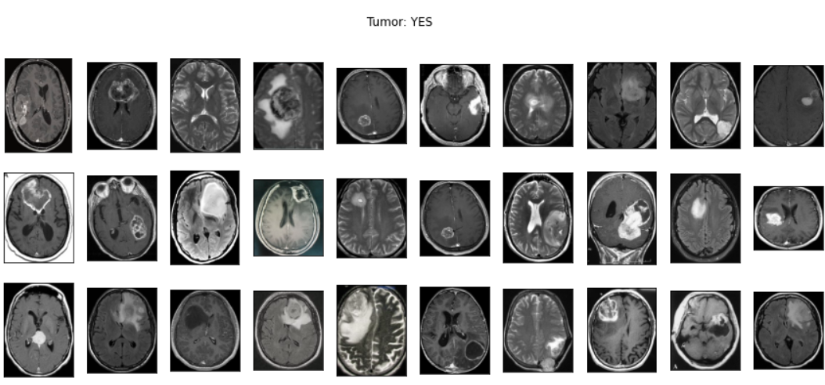

Slide 9
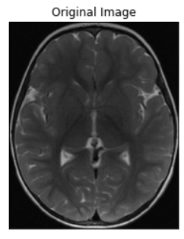
Augment

Slide 10
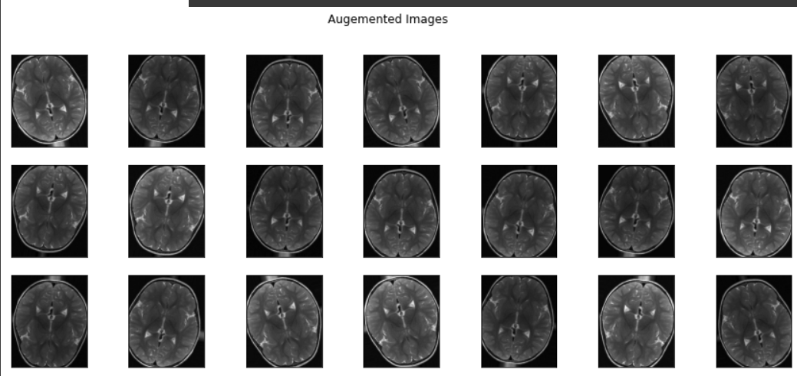

Slide 11
Modelling
BaseLine Model
VGG-16
ResNet50
EfficientNetB0

Slide 12
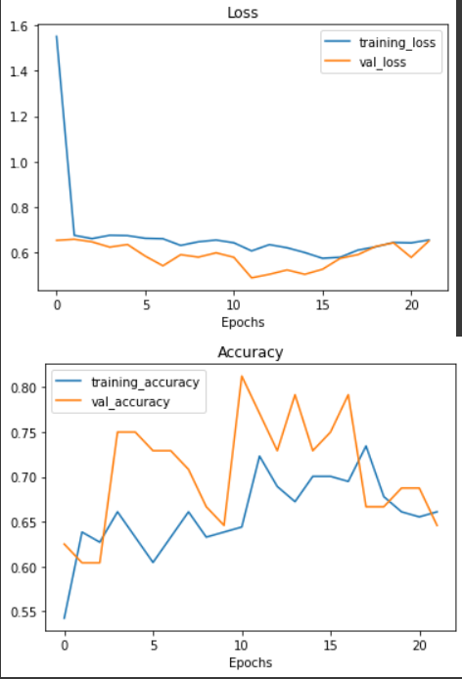
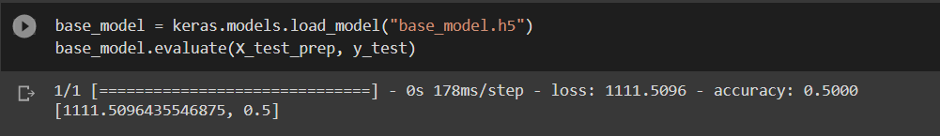
BaseLine Model

Slide 13
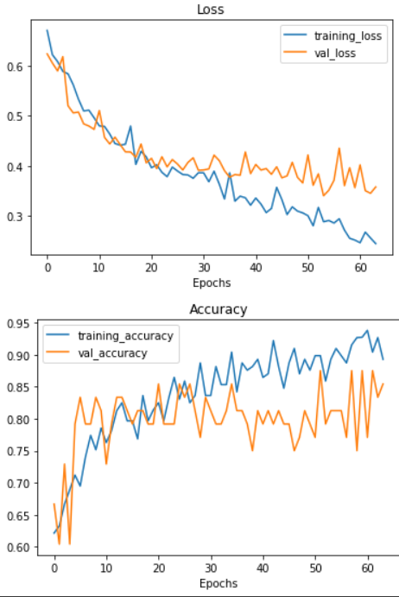
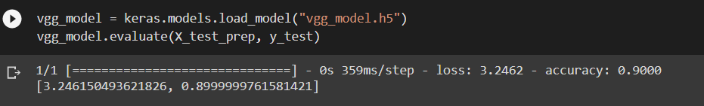
VGG-16

Slide 14
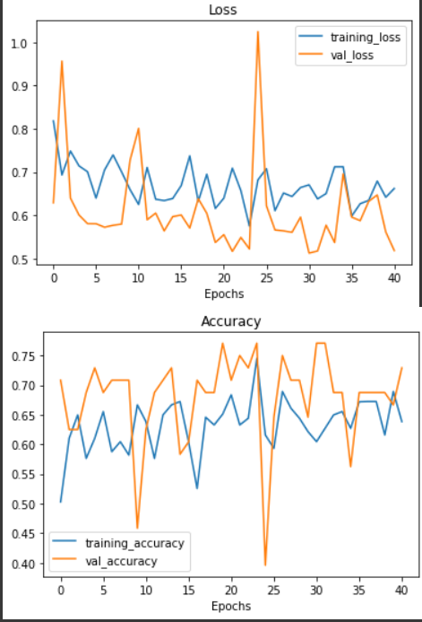
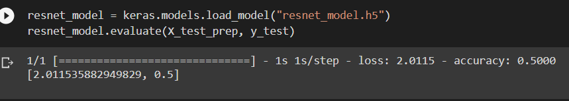
ResNet50

Slide 15
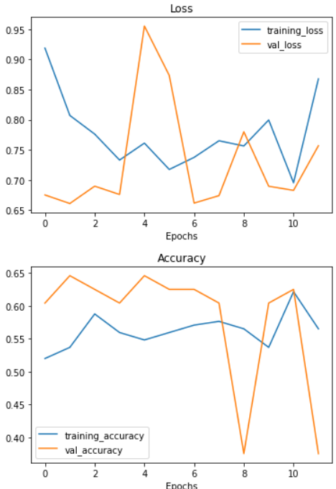
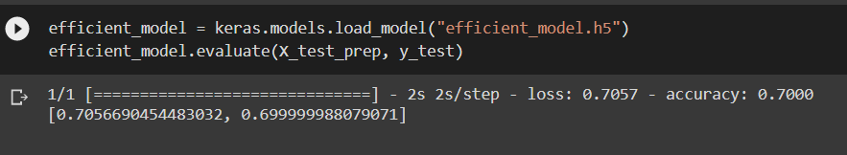
EfficientNetB0

Slide 16
Conclusion
The best model was VGG-16 with accuracy of 90% for unseen data

Slide 17

Thank You
See You Next Time

